Slide 1
Secure Data Hiding in Images Using Steganography
CAPSTONE PROJECT
Presented By
Student Name : Sweetha S
College Name & Department : Thiagarajar College of Engineering – Computer Science Engineering

Slide 2
OUTLINE
Problem Statement
Technology used
Wow factor
End users
Result
Conclusion
Git-hub Link
Future scope

Slide 3
Problem Statement
Need to hide sensitive information in digital media without detection.
Data loss from compression, unauthorized access, and inefficient retrieval.

Slide 4
Technology used
Libraries:
OpenCV (cv2): For image processing and manipulation.
os: For file and directory operations.
Platforms:
Python IDLE: A simple, built-in Integrated Development and Learning Environment for Python, offering basic tools for writing, running, and debugging code.

Slide 5
Wow factors
Password Protection: Ensures only authorized users can access the hidden message, adding an extra layer of security.
Lossless Image Format: Uses PNG to avoid data loss from compression, ensuring message integrity.
Pixel-Level Encryption: Embeds messages directly into image pixels, making it discreet and hard to detect.
User-Friendly: Simple and intuitive implementation, making it accessible for both technical and non-technical users.

Slide 6
End users
Government Agencies
Businesses/Corporations
Journalists/Whistleblowers
Security Professionals and Cryptographers
Researchers in Information Security
Digital Artists
End-Users in Private Communication
Media Companies
Law Enforcement and Forensics
Online Privacy Advocates

Slide 7
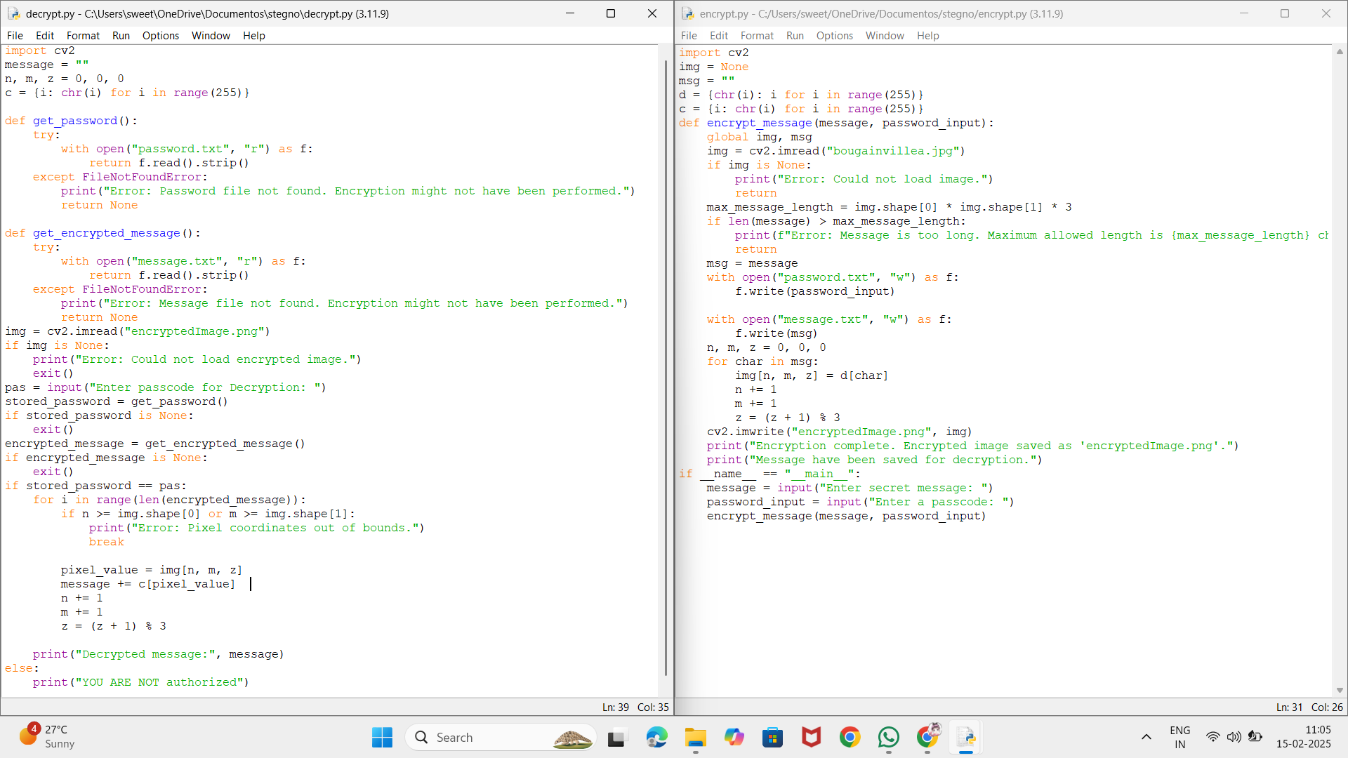
Results

Slide 8
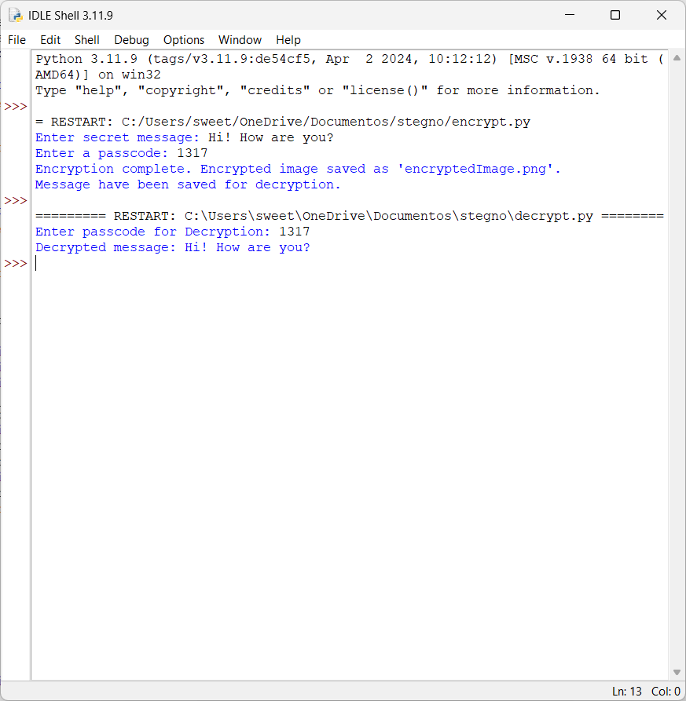
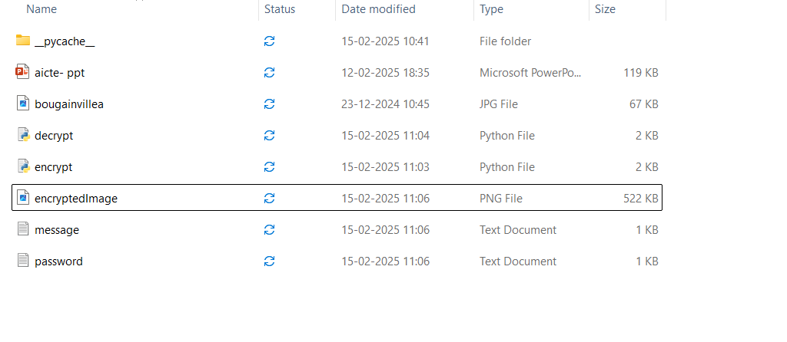
Results

Slide 9
Conclusion
This project provides a secure steganography-based solution for hiding and retrieving messages in images. By encrypting data and using password protection, it ensures robustness, prevents unauthorized access, and avoids data loss from compression. It offers a reliable and efficient method for secure communication.

Slide 10
GitHub Link
https://github.com/Sweetha-s/Stegnography.git

Slide 11
Future scope
Stronger Encryption: Use more advanced encryption methods for better data protection.
Cross-Platform Support: Make the system work on different devices like mobile phones and computers.
Real-Time Data Hiding: Allow data to be hidden and retrieved in real-time for live communication.
Extra Security Features: Add features like two-factor authentication for enhanced security.
Better Compression Handling: Improve the system’s ability to handle image compression without losing hidden data.

Slide 12
THANK YOU

